Slide 1

INDUSTRY VERTICALS/DOMAINS
TEAM NAME-THE PIONEERS
APOORVA V C
SHRINIDHI S
ABHISHEK MANOJ

Slide 2
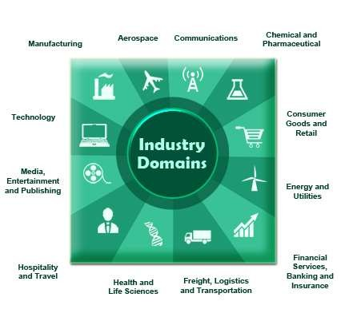

Domain and Industry Verticals:
Domain:
A business domain or an industry means a stream/area that provides a unique service as per the customer requirements.

Slide 3

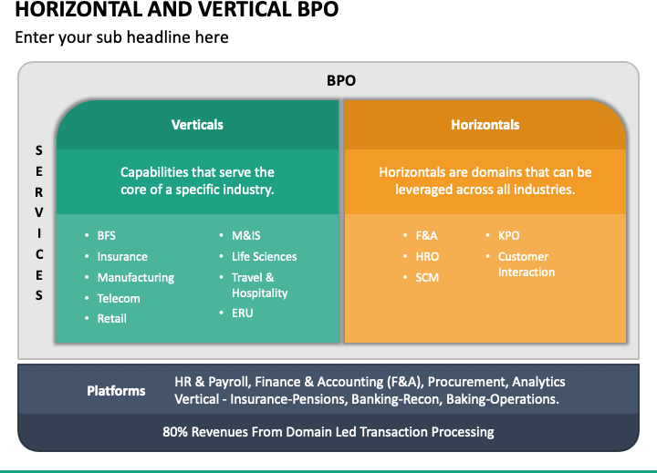
A Vertical focuses on Industry specific services (say Domain
specific) such as Life Sciences, Banking, Healthcare etc.
Verticals and Horizontals:
Horizontal focuses on services which are used in various Industries/Domains as Testing, Data Warehousing, Analytics.

Slide 4

Industry Verticals that the following company serves
PWC
KPMG
BOSTON CONSULTING GROUP

Slide 5
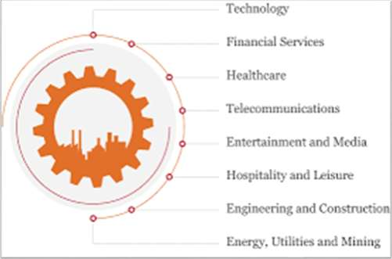
1. PWC
Automotive
Education
Entertainment and Media
Financial Services
Government and Public Sector
Oil and Gas
Technology , Media and Telecommunications

Slide 6
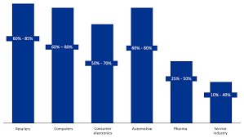
2. KPMG
Aerospace & Defence
Building & Construction
Energy & Natural Resources
Life Sciences
Telecommunications
Media

Slide 7


3.Boston Consulting Group
Automotive industry
Consumer product industry
Principal Investors and Private Equity
Travel and Tourism
Insurance Industry
AUTOMOTIVE INDUSTRY
CONSUMER PRODUCTS INDUSTRY
INDUSTRIAL GOODS
PRINCIPAL INVESTORS AND PRIVATE EQUITY
RETAIL INDUSTRY
TRANSPORTATION AND LOGISTICS

Slide 8

Tietoevry Industry Verticals
Banking & financial services
Energy & Utilities
Pulp, Paper, Fibre, Tissue & packaging
Case Management software
Digital commerce
PPS
Healthcare & welfare

Slide 9
Tietoevry custom-made offerings are expertly tailored to meet the unique demands and requirements of your specific industry, delivering personalized solutions designed to drive growth and success.
Tietoevry Banking Essentials have launched a brand new Corporate Mobile app to give corporate end users freedom to roam. Built on the same technology as our popular Mobile Banking app for the retail segment, we are taking self-service corporate banking to a new level.
Reno de Medici (RDM Group) has selected Tietoevry to modernize their core
business processes and enable digitalization in their nine mills.

Slide 10
THANK YOU

